Slide 2
Developing With Android
Dustin R. Welden
ACM Wichita
22 September 2010

Slide 3
Roadmap
Intro & Brief History
Android Architecture
Putting it in Practice
Future Development

Slide 5
What is Android?
Linux-based operating system
Mobile OS
Tablets

Slide 6
Brief History
Android, Inc. formed in Palo Alto, CA
Google acquires Android, Inc.
Speculations
Rumors Valid
HTC introduces the Dream
A.K.A. T-Mobile G1
First Android phone
Late 2003
July 2005
October 2008

Slide 7
Adoption Rates
Source: Gartner (August 2010)

Slide 8
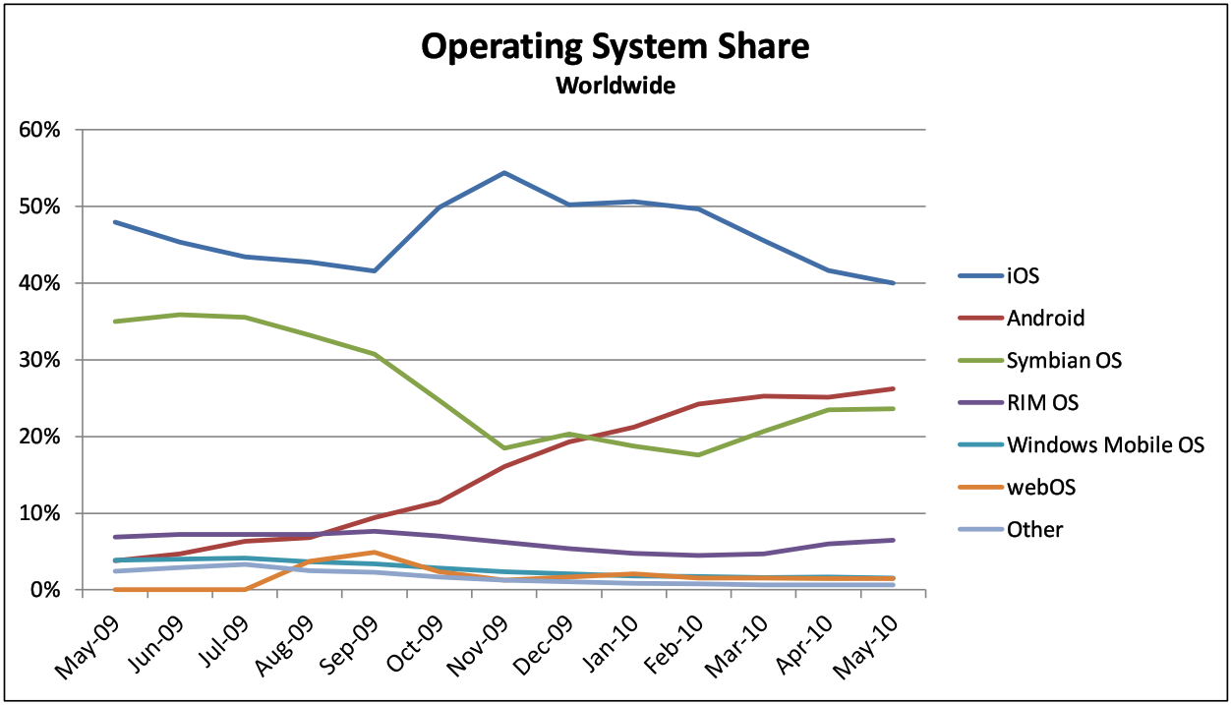
(Source: AdMob, May 2010)

Slide 9
What’s New in Android 2?
Exchange Support
Combined Inbox
SMS/MMS Search
Virtual Keyboard Improvements
Browser With HTML 5 Support
And more!

Slide 10
Why Android?
Open Source
Open Market
Revenue is Good

Slide 11
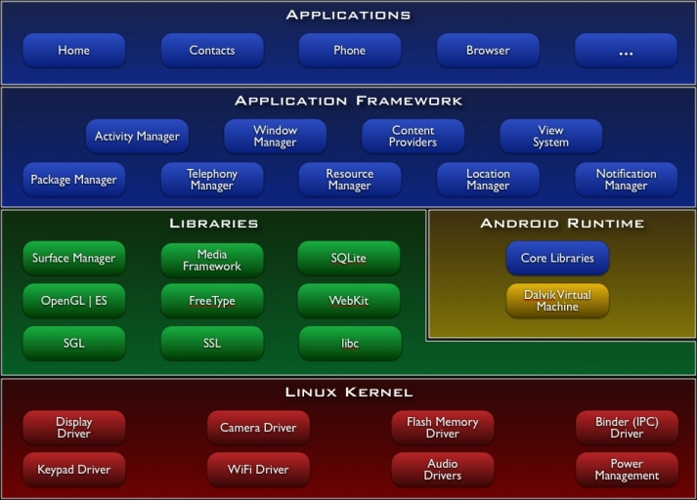
Android Architecture
Source: developer.android.com

Slide 12
Application Components
Activities
Services
Broadcast Receivers
Content Resolvers

Slide 13
Activities
Holds a View
Usually XML-based
UI starting point
Example: Browser

Slide 14
Services
Usually started within an activity
Sit in the background, perform tasks
Example: Music player service

Slide 15
Broadcast Receivers
Activated when searching for handler to a service or activity’s broadcast
No UI
Usually notification-oriented actions
Example: Battery Low notification

Slide 16
Content Providers
Not invoked directly
Retrieve/Store information
Not common
Activity Invocation alternative

Slide 17
Dive Into Code

Slide 19
Resources
Presentation Materials:
http://github.com/drwelden/Android-Presentation
Android SDK/Documentation:
http://developer.android.com/
Eclipse:
http://www.eclipse.org/
Me!
E-Mail: dustin.welden@gmail.com
Twitter: @drwelden

Slide 20
Questions?

